Slide 1
SAMUEL API
Sentiment Analyzing Machine that can Understand Enumerated Languages

Slide 2
OBJECTIVES

Slide 3
I. Features
A machine that can understand English and Tagalog language.
Classify the given sentiments in to three polarities (positive negative or neutral) and their respective percentage.
Summarize the given sentiments, opinions or comments on a particular topic, discussion, or argument and create a concise and compact conclusion out of it.
A Modular design of API that can be used and customized easily by any developers.
A comprehensive and easy to use Linkifier to parse and analyze a website with just a link of supported websites.

Slide 4
II. Creation and Implementation
Python as the core library of the API.
JSON will be the data interchange of the API.
For the implementation, a key will be provided for the developers to have access to the API.
A website for the following features:
Linkifier
To generate API Keys

Slide 5
METHODOLOGY

Slide 6
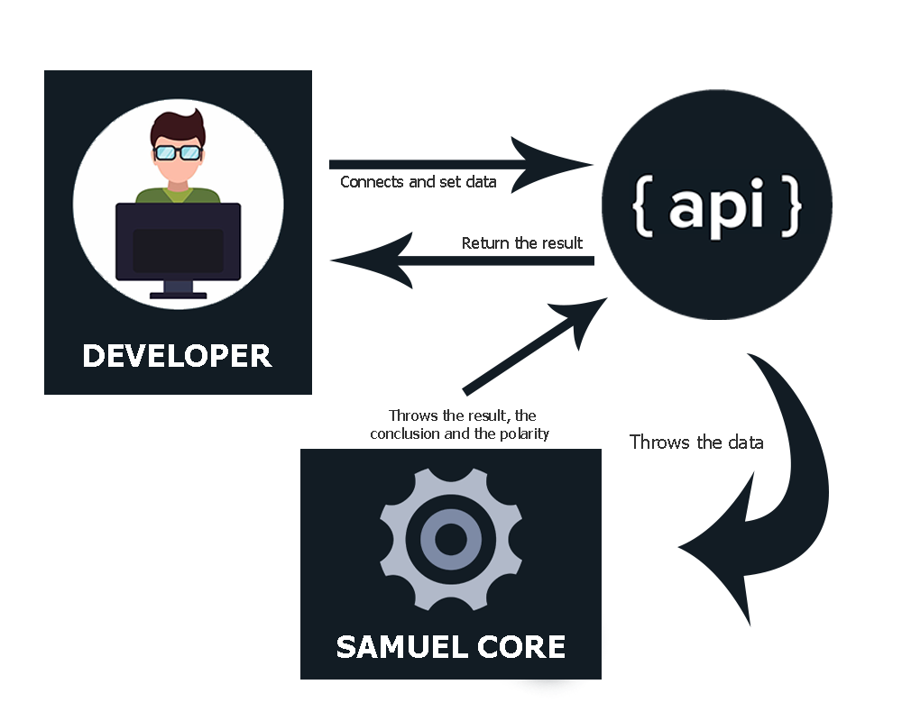
I. Project Design

Slide 7
I. Project Design
API Key Validation
Normalization
Feature Extraction
Topic Modelling
Summarizer
Return the Results

Slide 8
II. Project Development
Planned and designed the flow of core software for the API
Encoded the system flow
Developed all the modules
Tested the API

Slide 9
II. Operation and Testing Procedure
MODULES | TESTING PROCEDURES
Linkifier | Paste the link Select the linkify button then proceed
API Key Creation | Register to SAMUEL API website Go to API Keys Click Add Key Enter the name of the key then click add

Slide 10
II. Operation and Testing Procedure
MODULES | TESTING PROCEDURES
API Key Validation | Copy the API Key Use the API Key to connect to SAMUEL
SAMUEL Core Normalization Feature Extraction Topic Modelling Summarizer | Set all the data needed Post request to SAMUEL API Display the return data Polarity & Percentage Summarized Text Dashboard

Slide 11
RESULTS

Slide 12
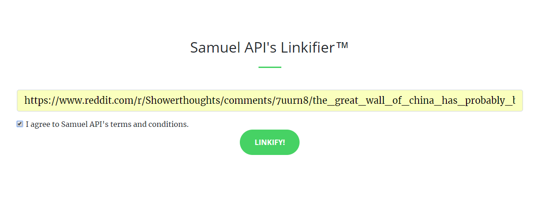
Module: Linkifier

Slide 13
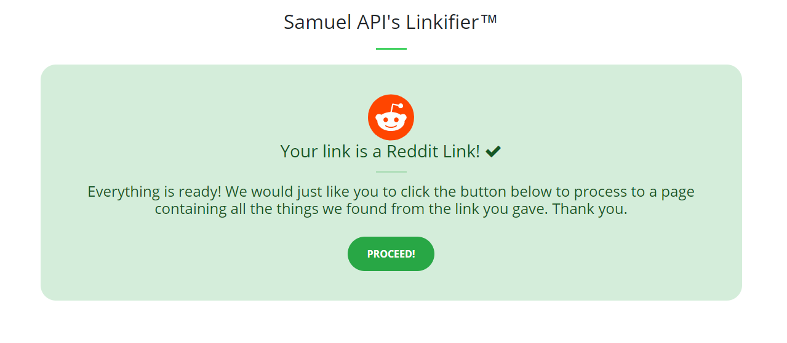
Module: Linkifier

Slide 14
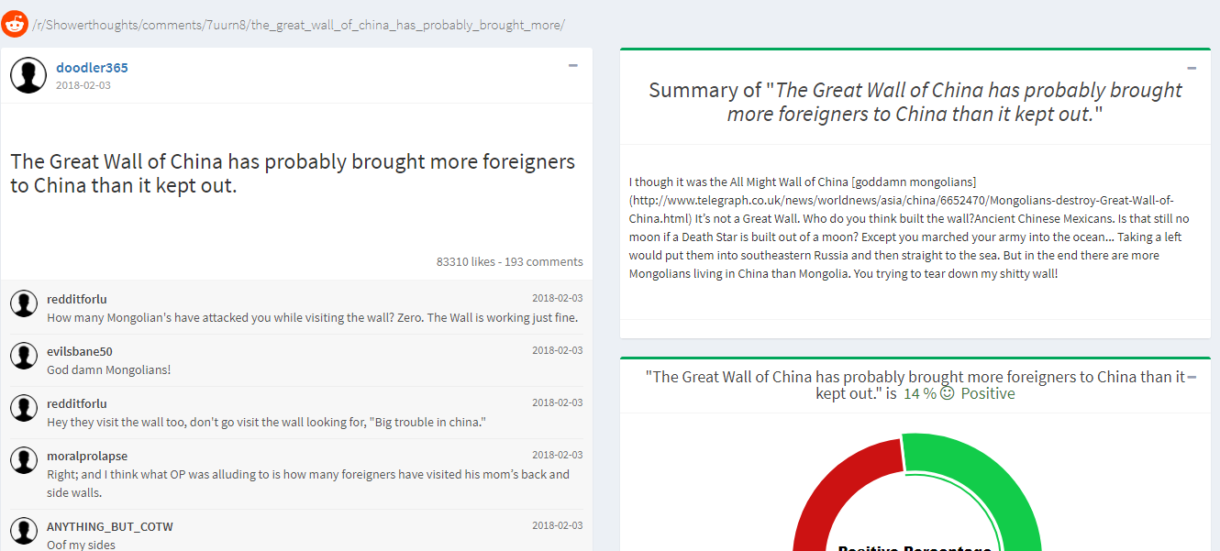
Module: Linkifier

Slide 15
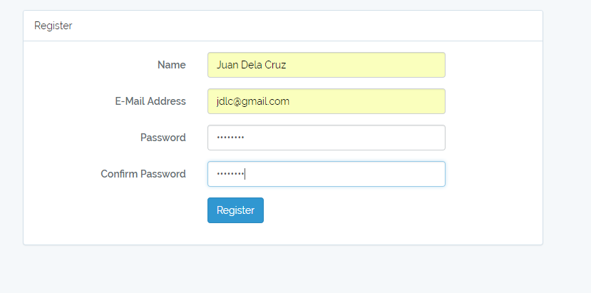
Module: API Key Creation

Slide 16
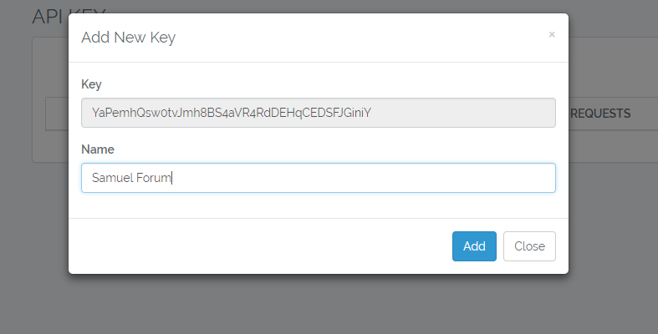
Module: API Key Creation

Slide 17
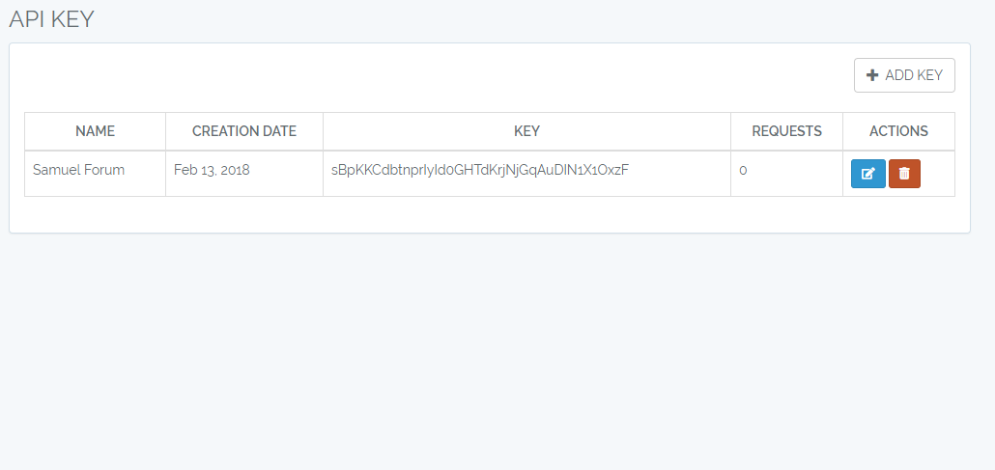
Module: API Key Creation

Slide 18
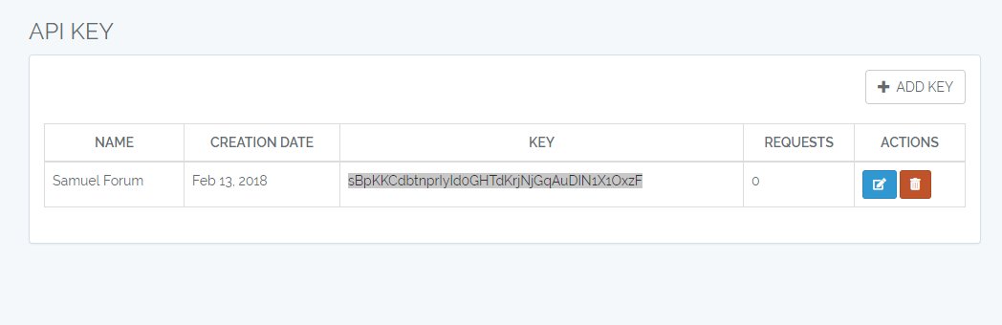
Module: API Key Validation

Slide 19
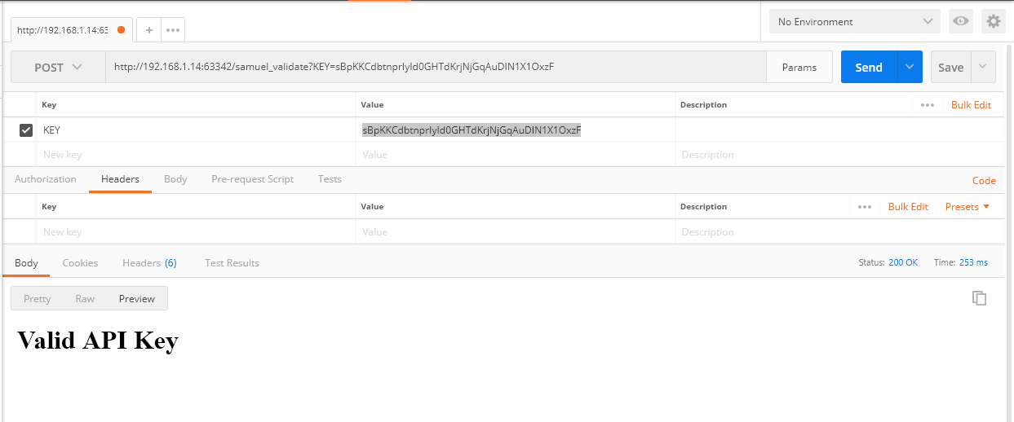
Module: API Key Validation

Slide 20
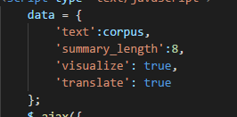
Module: Samuel Core

Slide 21
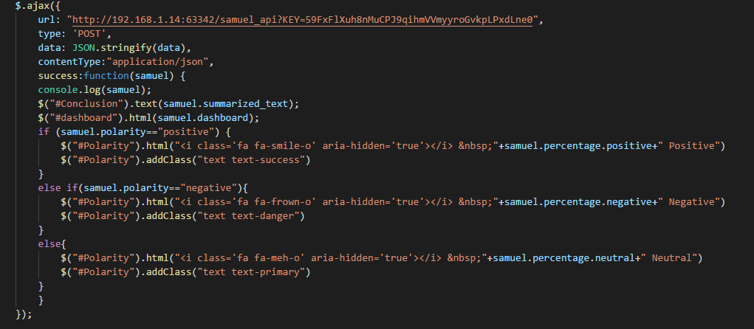
Module: Samuel Core

Slide 22
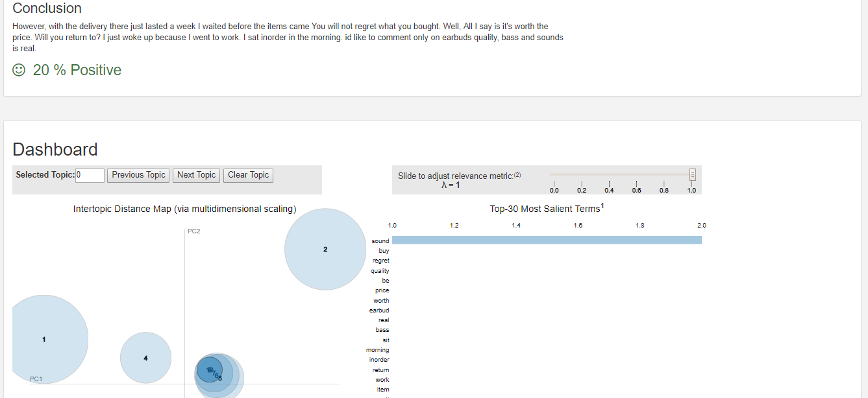
Module: Samuel Core

Slide 23
DEMO

